Slide 1
Chapter 15 Chi-Squared Tests
Copyright © 2022 McGraw Hill. All rights reserved. No reproduction or distribution without the prior written consent of McGraw Hill.
1-1

Slide 2
Chapter Learning Objectives
Chapter 15
LO15-1: Recognize a contingency table and understand how it is created.
LO15-2: Find degrees of freedom and use the chi-square table of critical values.
LO15-3: Perform a chi-square test for independence on a contingency
table.
LO15-4: Perform a goodness-of-fit (GOF) test for a multinomial distribution.
LO15-5: Perform a GOF test for a uniform distribution.
LO15-6: Explain the GOF test for a Poisson distribution.
LO15-7: Explain the chi-square GOF test for normality.
LO15-8: Interpret ECDF tests and know their advantages.

Slide 3
Chi-Squared Tests for Independence
Chapter 15
Not all information pertaining to business can be summarized numerically.
We are often interested in answers to questions such as: Do employees in different age groups choose different types of health plans? Do consumers prefer red, yellow, or blue package lettering on our bread bags? Does the name of our new lawn mower influence how we perceive the quality?
Answers to questions such as these are not measurements on a numerical scale. Rather, the variables that we are interested in learning about may be categorical or ordinal.

Slide 4
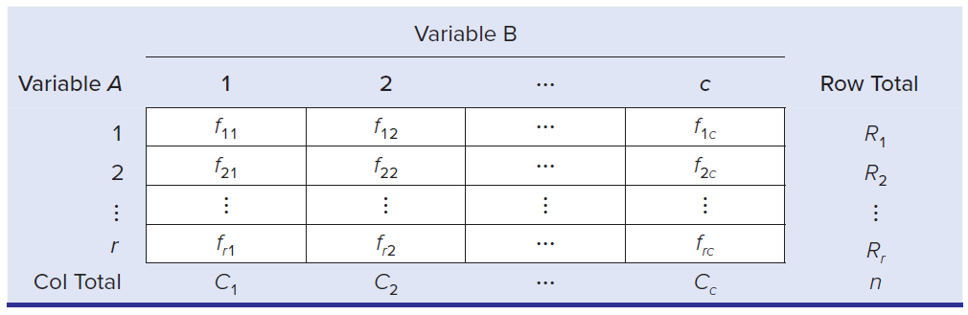
Contingency Tables
LO 15-1
A contingency table is a cross-tabulation of n paired observations into categories. Each cell shows the count of observations that fall into the category defined by its row and column heading.

Slide 5
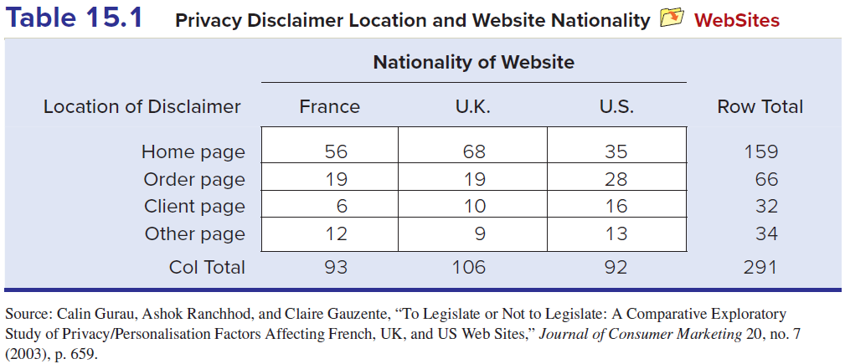
Contingency Tables
LO 15-1
For example: Marketing researchers did a survey of 291 websites in three nations (France, U.K., U.S.) and obtained the contingency table shown here. Is location of the privacy disclaimer independent of the website’s nationality? This question can be answered by using a test based on the frequencies in this contingency table.

Slide 6
Chi-Squared Test
LO 15-1
In a test of independence for an r × c contingency table, the hypotheses are
H0: Variable A is independent of variable B
H1: Variable A is not independent of variable B
Use the chi-square test for independence to test these hypotheses.
This non-parametric test is based on frequencies.
The n data pairs are classified into c columns and r rows, and then the observed frequency f_{jk} is compared with the expected frequency e_{jk} under the assumption of independence.

Slide 7

Chi-Square Test
LO 15-1
The chi-square test statistic measures the relative difference between expected and observed frequencies:
If the two variables are independent, then f_{jk} should be close to e_{jk}, leading to a chi-square test statistic near zero.
Conversely, large differences between f_{jk} and e_{jk} will lead to a large chi-square test statistic.
The chi-square test statistic cannot be negative (due to squaring) so it is always a right-tailed test.
If the test statistic is far enough in the right tail, we will reject the hypothesis of independence.

Slide 8
Chi-Square Distribution
LO 15-2
The critical value comes from the chi-square probability distribution with (r – 1)(c – 1) degrees of freedom.
df = degrees of freedom = (r – 1)(c – 1)
where
r = number of rows in the table
c = number of columns in the table
Critical values for right-tail areas of the Chi-Square distribution can be found in Appendix E or in Excel using the function = CHISQ.INV.RT(α, df).

Slide 9
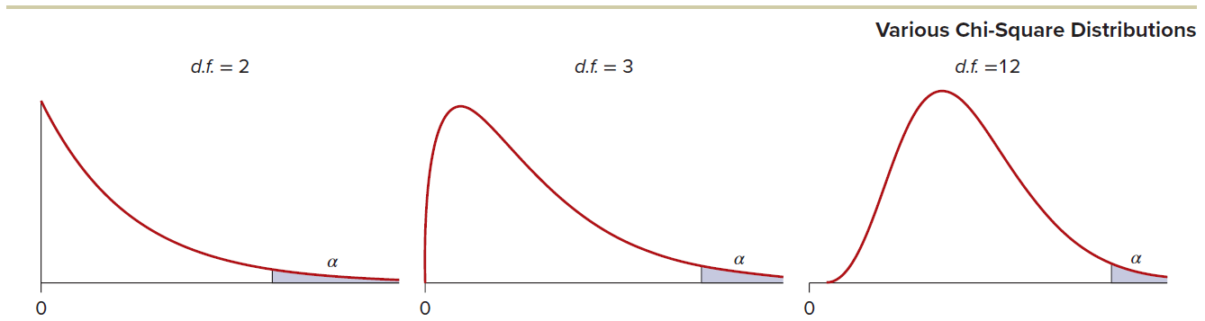
Chi-Square Distribution
LO 15-2
Consider the shape of the chi-square distribution. As the degrees of freedom increases, the shape begins to resemble a normal, bell-shaped curve.
However, for any contingency table you are likely to encounter, degrees of freedom will not be large enough to assume normality.

Slide 10
Expected Frequencies
LO 15-2
Assuming that H₀ is true, the expected frequency of row j and column k is:
Where
R_{j} = total for row j (j = 1, 2, …, r)
C_{k} = total for column k (k = 1, 2, …, c)
n = sample size

Slide 11
Testing the Hypotheses
LO 15*3
Step 1: State the Hypotheses
H₀: Privacy disclaimer location is independent of website nationality
H₁: Privacy disclaimer location is dependent on website nationality
Step 2: Specify the Decision Rule
Calculate df = (r – 1)(c – 1)
For a given α, look up the right-tail critical value (χ²_{R}) from Appendix E or by using Excel.
Reject H₀ if test statistic > χ²_{R}.

Slide 12
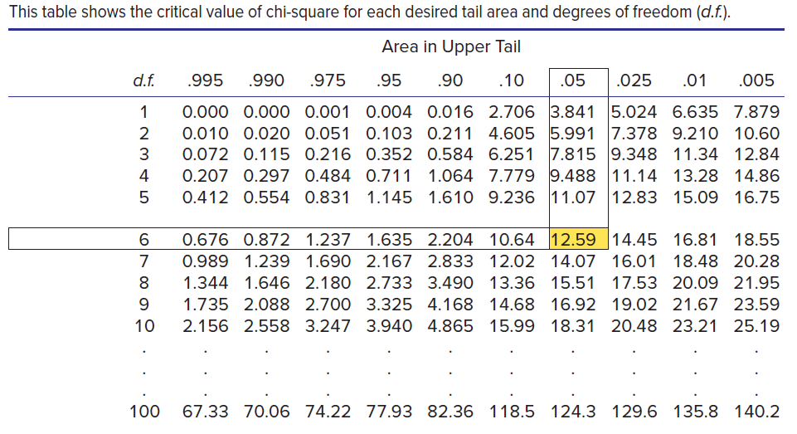
Testing the Hypothesis
LO 15-3
For example, for df = 6 and α = .05, χ²_{.05} = 12.59.

Slide 13
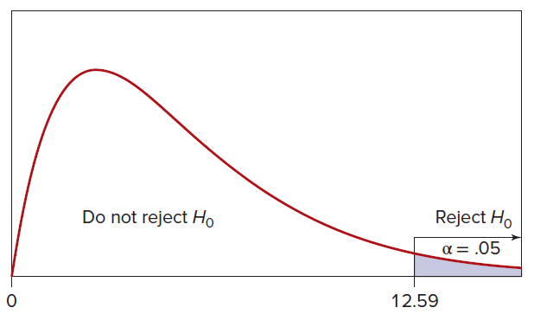
Testing the Hypothesis
LO 15-3
For α = .05 in this right-tailed test, the decision rule is
Reject H₀ if χ²_{calc} > 12.59
Otherwise, do not reject H₀

Slide 14
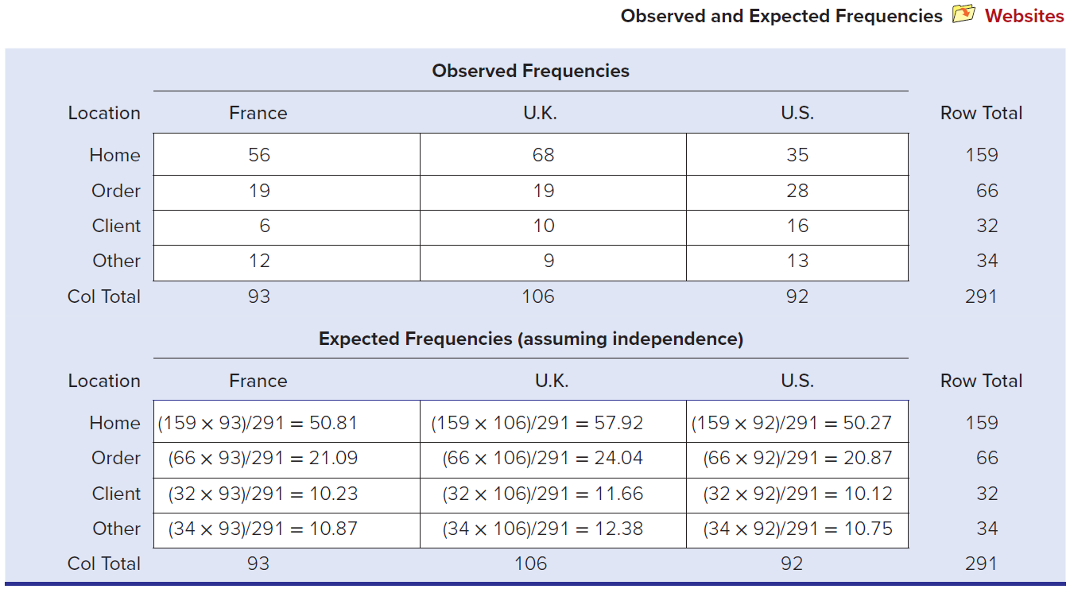
Testing the Hypothesis
LO 15-3
Step 3: Calculate the Test Statistic
The expected frequency in row j and column k is e_{jk} = R_{j}C_{k} ⁄n.

Slide 15
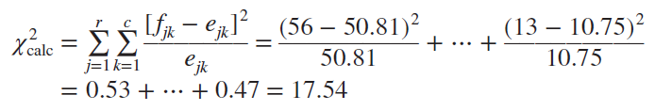
Testing the Hypothesis
LO 15-3
The chi-square test statistic is
Step 4: Make the Decision
Because the test statistic χ²_{calc} = 17.54 exceeds 12.59, we conclude that the observed differences between expected and observed frequencies differ significantly at α = .05. The p-value (.0075) indicates that H₀ should be rejected at α = .05.
Step 5: Take Action
These results suggest that in the United States, the privacy disclaimer placement is more evenly distributed between various website pages when compared to France and the United Kingdom.

Slide 16
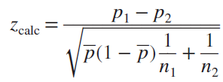


Test of Two Proportions
LO 15-3
For a 2 × 2 contingency table, the chi-square test is equivalent to a two-tailed z test for two proportions, if the samples are large enough to ensure normality.
The hypotheses are:
H₀: π₁ − π₂ = 0
H₁: π₁ − π₂ ≠ 0
The z test statistic is:
Where the pooled proportion is:

Slide 17
Small Expected Frequencies
LO 15-3
The chi-square test is unreliable if the expected frequencies are too small.
A commonly used rule of thumb known as Cochran’s Rule requires that e_{jk} > 5 for all cells.
Another rule of thumb says that up to 20 percent of the cells may have e_{jk} < 5.
Most agree that a chi-square test is infeasible if e_{jk} < 1 in any cell.
If this happens, try combining adjacent rows or columns to enlarge the expected frequencies.

Slide 18
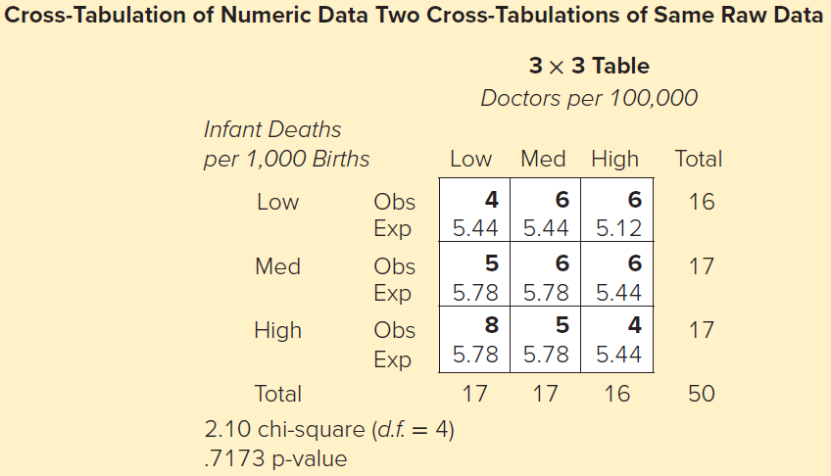
Cross-Tabulating Raw data
LO 15-3
Chi-square tests for independence are quite flexible. Although most often used with nominal data such as gender (male, female), we also can analyze quantitative variables (such as salary) by coding them into categories (e.g., under $25,000; $25,000 to $50,000; $50,000 and over).
For example, the variables Infant Deaths per 1,000 and Doctors per 100,000 can each be coded into various categories.

Slide 19
Why Do a Chi-Square Test on Numerical Data?
LO 15-3
The researcher may believe there’s a relationship between X and Y, but doesn’t want to make an assumption on its form (linear, quadratic etc.) as required by regression.
There are outliers or anomalies that prevent us from assuming that the data came from a normal population. Unlike correlation and regression, the chi-square test does not require any normality assumptions.
The researcher has numerical data for one variable but not the other. A chi-square test can be used if we convert the numerical variable into categories.

Slide 20
3-Way Tables and Higher
LO 15-3
More than two variables can be compared using contingency tables.
However, it is difficult to visualize a higher order table.
For example, you could visualize a cube as a stack of tiled 2-way contingency tables.
Major computer packages permit 3-way tables.

Slide 21
Goodness of Fit Tests
LO 15-4
A goodness-of-fit test (or GOF test) is used to help you decide whether your sample resembles a particular kind of population.
The chi-square test can be used to compare sample frequencies with any probability distribution.
A multinomial distribution is defined by any k probabilities π₁, π₂, . . . , π_{k} that sum to one.
You can apply this same technique for the three familiar distributions we have already studied (uniform, Poisson, and normal).

Slide 22

Multinomial GOF Tests: M&M Colors
LO 15-4
According to the “official” M&M website, the distribution of M&M colors is
But do bags of M&Ms shipped to retailers actually follow this distribution?
We will use a sample of four bags of candy and conduct a chi-square GOF test.
We will assume the distribution is the same as stated on the website unless the sample shows us otherwise.

Slide 23
Multinomial GOF Tests: M&M Colors
LO 15-4
The hypotheses are:
H₀: π_{brown} = .13, π_{red} = .13, π_{blue} = .24, π_{orange} = .20, π_{yellow} = .16, π_{green} = .14
H1: At least one of the π’s differs from the hypothesized value
To test these hypotheses, statistics students opened four bags of M&Ms (n = 220 pieces) and counted the number of each color, with the results shown on the next slide.
We assign an index to each of the six colors ( j = 1, 2, . . . , 6) and define
f_{j} = the actual frequency of M&Ms of color j
e_{j} = the expected frequency of M&Ms of color j assuming that H₀ is true

Slide 24

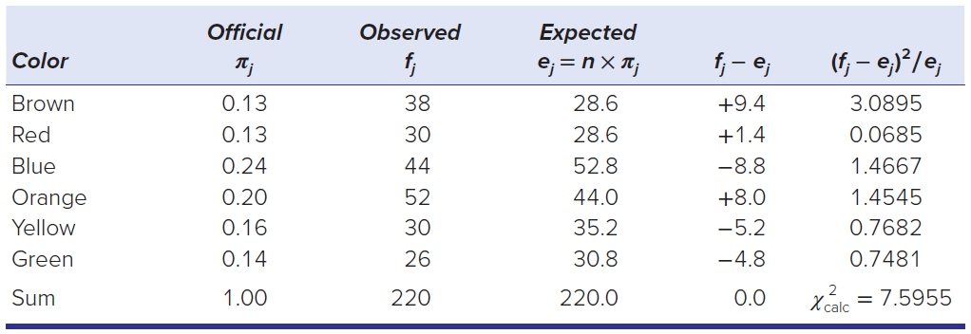
Multinomial GOF Tests: M&M Colors
LO 15-4
Each expected frequency (e_{j}) is calculated by multiplying the sample size (n) by the hypothesized proportion (π_{j}). We can now calculate a chi-square test statistic that compares the actual and expected frequencies:

Slide 25


Multinomial GOF Tests: M&M Colors
LO 15-4
We will reject H0 if the test statistic exceeds the chi-square critical value chosen from Appendix E. For any GOF test, the rule for degrees of freedom is
where c is the number of classes used in the test and m is the number of parameters estimated.
No parameters were estimated (m = 0) and we have six classes (c = 6), so degrees of freedom are
From Appendix E, the critical value of chi-square for α = .01 is χ²_{.01} = 15.09.
Because the test statistic χ²_{calc} = 7.5955 is smaller than the critical value, we cannot reject the hypothesis that the M&M’s color distribution is as stated on the M&M website.

Slide 26
Multinomial GOF Tests
LO 15-4
If the proposed distribution gives a good fit to the sample, the test statistic will be near zero.
The test statistic follows the chi-square distribution with c – m – 1 degrees of freedom df = c – m – 1.
where c is the number of classes (bins) used in the test and m is the number of parameters estimated.

Slide 27
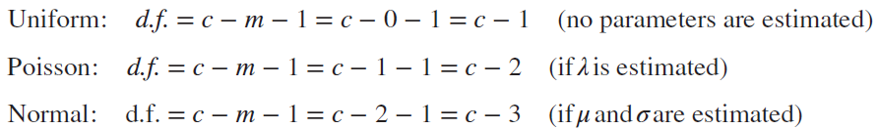
GOF Tests for Other Distributions
LO 15-4
We also can use the chi-square GOF test to compare a sample of data with a familiar distribution such as the uniform, Poisson, or normal.
We would state the hypotheses as below:
H₀: The population follows a _____ distribution.
H₁: The population doesn’t follow a _____ distribution.
The blank may contain the name of any theoretical distribution.
In a GOF test, if we use sample data to estimate the distribution’s parameters, then our degrees of freedom would be as follows:

Slide 28
Data-Generating Situations
LO 15-4
Instead of “fishing” for a good-fitting model, visualize a priori the characteristics of the underlying data-generating process.
The proposed model should be both logical and empirically apt.
The most common GOF test is for the normal distribution because so many parametric tests assume normality, and that assumption must be tested. Also, the normal distribution may be used as a benchmark for any mound-shaped data that have centrality and tapering tails, as long as you have reason to believe that a constant mean and variance would be reasonable (e.g., weights of circulated dimes).

Slide 29
Mixtures: A Problem
LO 15-4
Your sample may not resemble any known distribution. One common problem is mixtures. A sample may have been created by more than one data-generating process superimposed on top of another.
For example, adult heights of either sex would follow a normal distribution, but a combined sample of both genders will be bimodal, and its mean and standard deviation may be unrepresentative of either sex.

Slide 30
Eyeball Tests
LO 15-4
A simple “eyeball” inspection of the histogram or dot plot may suffice to rule out a hypothesized population.
For example, if the sample is strongly bimodal or skewed or if outliers are present, we would anticipate a poor fit to a normal distribution. The shape of the histogram can give you a rough idea whether a normal distribution is a likely candidate for a good fit.
You can be fairly sure that a formal test will agree with what your common sense tells you, as long as the sample size is not too small.
A limitation of eyeball tests is that we are sometimes unduly impressed by a small departure from the hypothesized distribution, when actually it is within chance.

Slide 31
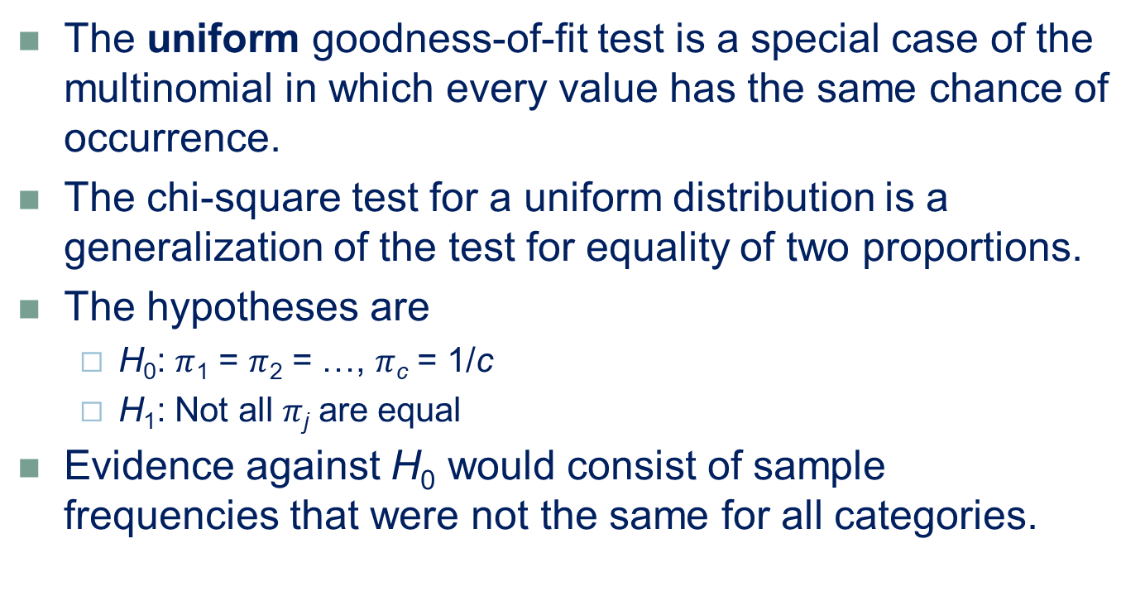
Uniform Goodnss-of-Fit-Test
LO 15-5
The uniform goodness-of-fit test is a special case of the multinomial in which every value has the same chance of occurrence.
The chi-square test for a uniform distribution is a generalization of the test for equality of two proportions.
The hypotheses are
H₀: $π$₁ = $π$₂ = …, $π$_{c} = 1/c
H₁: Not all $π$_{j} are equal
Evidence against H₀ would consist of sample frequencies that were not the same for all categories.

Slide 32
Uniform GOF Test: Grouped Data
LO 15-5
The test is easiest if data are already tabulated into groups, which saves us the effort of defining the groups.
For example, one year, a certain state had 756 traffic fatalities. The table on the next slide suggests that fatalities are not uniformly distributed by day of week, being higher on weekends.
Can we reject the hypothesis of a uniform distribution, say, at α = .005?
The hypotheses are
H₀: Traffic fatalities are uniformly distributed by day of the week
H₁: Traffic fatalities are not uniformly distributed by day of the week

Slide 33
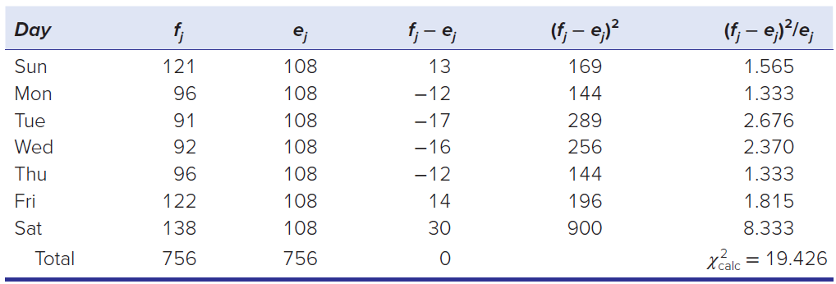
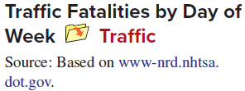
Uniform GOF Test: Grouped Data
LO 15-5
Under H₀ the expected frequency for each weekday is e_{j} = n/c = 756/7 = 108.
The chi-square test will have d.f. = c − m − 1 = 7 − 0 − 1 = 6 degrees of freedom giving a critical value of χ²_{.01} = 16.81
The hypothesis of a rectangular or uniform population can be rejected.

Slide 34
Uniform GOF Test: Raw Data
LO 15-5
When we are using raw data, we must form c bins of equal width and create our own frequency distribution.
For example, suppose an auditor is checking the fairness of a state’s “Daily 3” lottery. Table on the next slide shows winning three-digit lottery numbers for 100 consecutive days.
All numbers from 000 to 999 are supposed to be equally likely, so the auditor is testing these hypotheses:
H₀: Lottery numbers are uniformly distributed
H₁: Lottery numbers are not uniformly distributed

Slide 35
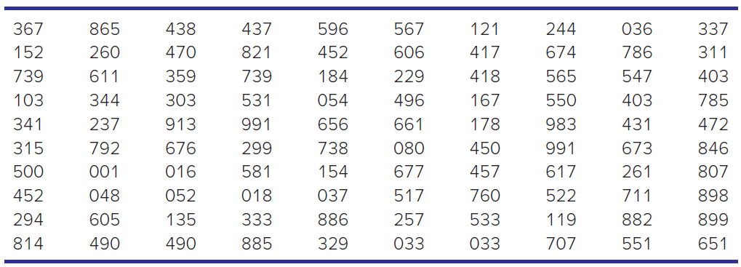

Uniform GOF Test: Raw Data
LO 15-5
Step 1 Divide the range into 10 bins of equal width.
Step 2 Calculate the observed frequency fj for each bin.
Step 3 Define ej = n/c = 100/10 = 10.
Step 4 Perform the chi-square calculations.
Step 5 Make the decision.

Slide 36
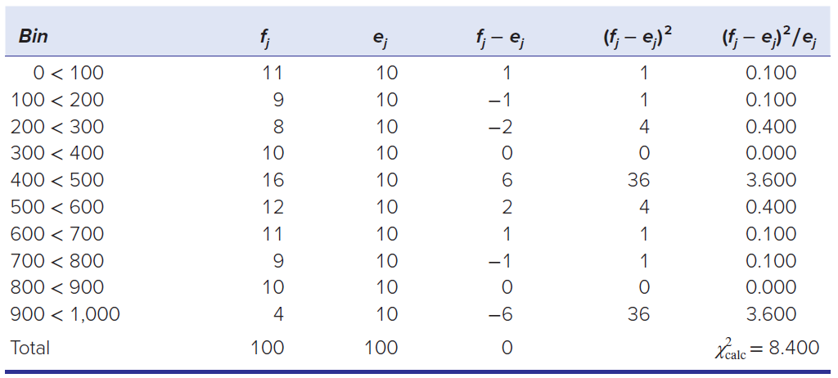
Uniform GOF Test: Raw Data
LO 15-5
Degrees of freedom equal c − m − 1 = 10 − 0 − 1 = 9 giving us a critical value of χ²_{.10} = 14.684.
Because the test statistic is 8.400, the hypothesis of a uniform distribution cannot be rejected.

Slide 37
Poisson GOF Test
LO 15-6
In a Poisson distribution model, X represents the number of events per unit of time or space.
X is a discrete nonnegative random variable with integer values (0, 1, 2, . . .).
Event arrivals must be independent of one another.
Events that tend to fit this definition might include customer arrivals per minute at an ATM, calls per minute at Ticketmaster, or alarms per hour at a fire station. In such cases, the mean arrival rate would vary by time of day, day of the week, and so on.

Slide 38
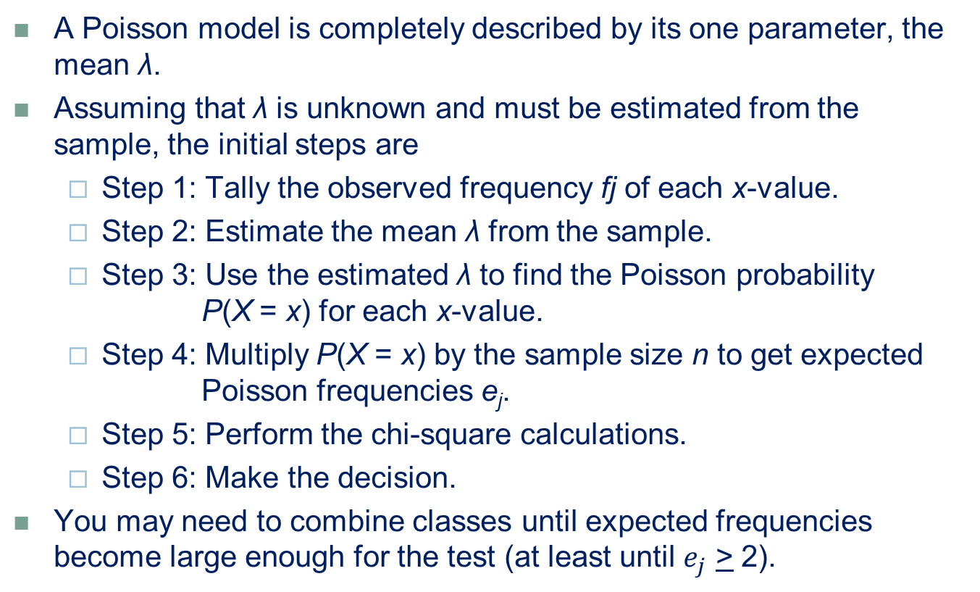
Poisson GOF Test
LO 15-6
A Poisson model is completely described by its one parameter, the mean λ.
Assuming that λ is unknown and must be estimated from the sample, the initial steps are
Step 1: Tally the observed frequency fj of each x-value.
Step 2: Estimate the mean λ from the sample.
Step 3: Use the estimated λ to find the Poisson probability P(X = x) for each x-value.
Step 4: Multiply P(X = x) by the sample size n to get expected Poisson frequencies e_{j}.
Step 5: Perform the chi-square calculations.
Step 6: Make the decision.
You may need to combine classes until expected frequencies become large enough for the test (at least until $e_{j}$ > 2).

Slide 39
Poisson GOF Test: Tabulated Data
LO 15-6
The number of U.S. Supreme Court appointments in a given year might be hypothesized to be a Poisson variable because rare events that occur independently over time are often well approximated by the Poisson model.
We formulate these hypotheses:
H₀: Supreme Court appointments follow a Poisson distribution
H₁: Supreme Court appointments do not follow a Poisson distribution

Slide 40
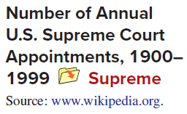
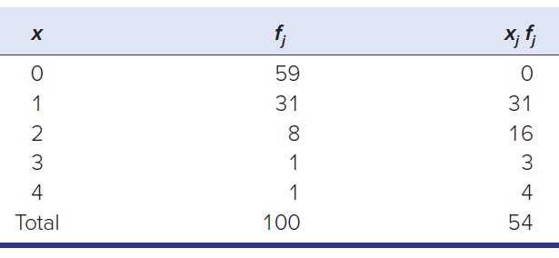


Poisson GOF Test: Tabulated Data
LO 15-6
The frequency of U.S. Supreme Court appointments for the period 1900 through 1999 is summarized in the table. This sample of 100 years should be large enough to obtain a valid hypothesis test. In a typical year, there are no appointments, and only twice have there been three or four appointments (1910 and 1941).
Total number of appointments Sample Mean

Slide 41
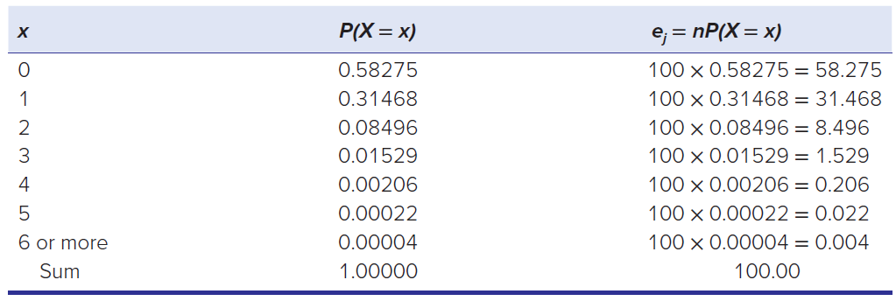

Poisson GOF Test: Tabulated Data
LO 15-6
Using the estimated mean $\hat{\text{λ}}$ = 0.54, we can calculate the Poisson probabilities, either by using the Poisson formula P(X = x) = (λ^{x}e^{− λ}/x! or Excel’s function =POISSON.DIST(x, mean, 0). We multiply P(X = x) by n to get the expected frequencies, with n = 100 years, as shown

Slide 42
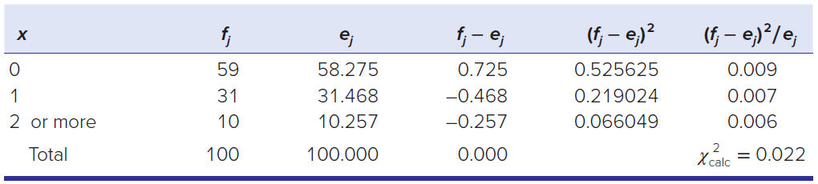
Poisson GOF Test: Tabulated Data
LO 15-6
The probabilities rapidly become small as X increases.
Because f_{j} and e_{j} are almost identical, the Poisson distribution obviously gives an excellent fit, so we are not surprised that the test statistic (0.022) is very near zero.
Using c = 3 classes in the test and with m = 1 parameter estimated, the degrees of freedom are c − m − 1 = 3 − 1 − 1 = 1. The critical value for α = .10 is χ²_{.10} = 2.706
We cannot reject the hypothesis of a Poisson distribution.

Slide 43
Normal Chi-Square GOF Test
LO 15-7
Any normal population is fully described by the two parameters μ and σ.
Many data-generating situations could be compatible with a normal distribution if the data possess a reasonable degree of central tendency and are not badly skewed.
For example, measurements of continuous variables such as physical attributes (e.g., weight, size, travel time) would tend to have a constant mean and variance if the underlying process is stable and the population is homogeneous.

Slide 44
Normal Chi-Square GOF Test
LO 15-7
The chi-square test requires c bins.
The most efficient method is to define histogram bins in such a way that an equal number of observations would be expected within each bin under the null hypothesis.
We define bin limits so that
e_{j} = n / c (define bins to get equal expected frequencies)
We divide the area under the normal curve to put a probability of 1/c in each of the c bins. The first and last classes must be open-ended for a normal distribution, so to define c bins, we need c − 1 cutpoints.
Once the bins are defined, we count the observations fj within each bin and compare them with the expected frequencies e_{j} = n/c.

Slide 45

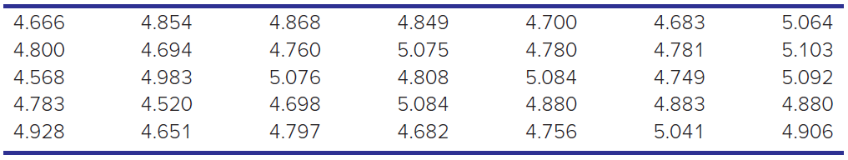
Application: Quality Management
LO 15-7
A sample of 35 Hershey’s Milk Chocolate Kisses was taken from a bag containing 84 Kisses. The population is assumed infinite. After removing the foil wrapper, each Kiss was weighed. The weights are shown. Are these weights from a normal population?

Slide 46
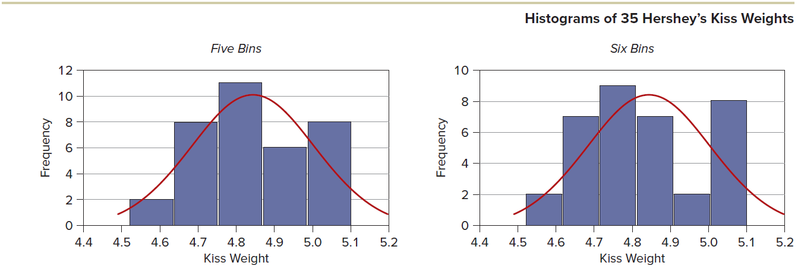
Application: Quality Management
LO 15-7
We will test the following hypotheses:
H₀: Kisses’ weights are from a normal distribution
H₁: Kisses’ weights are not from a normal distribution
The graphs show fitted normal distributions based on the estimated mean and standard deviation from the data.

Slide 47
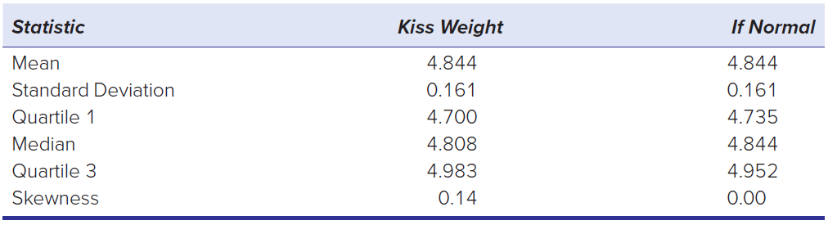
Application: Quality Management
LO 15-7
The table compares the sample statistics with parameters expected for a normal distribution.
The sample median is near the sample mean, and the skewness coefficient is fairly close to the value (0.00) that would be expected in a symmetric normal distribution. The sample quartiles are nearly what we expect for a normal distribution using the 25th and 75th percentiles. There are no outliers, as the smallest Kiss is 2.01 standard deviations below the mean, while the largest Kiss is 1.61 standard deviations above the mean.

Slide 48
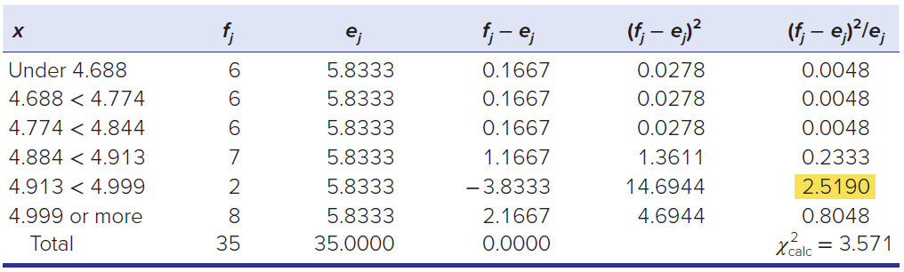
Application: Quality Management
LO 15-7
The degrees of freedom are d.f. = c − m − 1, where c is the number of classes used in the test and m is the number of parameters estimated. Because two parameters, μ and σ, are estimated from the sample of Kiss weights, we use m = 2.
Use 6 bins for our GOF test with d.f. = c − m − 1 = 6 − 2 − 1 = 3.
The GOF test in Table 15.20 shows that the chi-square test statistic (3.571) is not significant at α = .10 (χ²_{.10} = 6.251).

Slide 49
ECDF Tests
LO 15-8
There are alternatives to the chi-square test for goodness of fit. These alternatives are based on the empirical cumulative distribution function (ECDF).
The Anderson-Darling test is perhaps the most widely used test for non-normality because of its power.
The A-D test is based on a probability plot.
The A-D test statistic measures the overall distance between the actual and the hypothesized distributions using a weighted squared distance.

Slide 50

ECDF Tests
LO 15-8
Another useful ECDF test is the Kolmogorov-Smirnov test. The K-S test statistic D is the largest absolute difference between the actual and expected cumulative relative frequency of the n data values:
K-S test assumes that no parameters are estimated. If parameters are estimated, use a Lilliefors test whose test statistic is the same but with a different table of critical values. Both tests are done by computer.

Slide 51
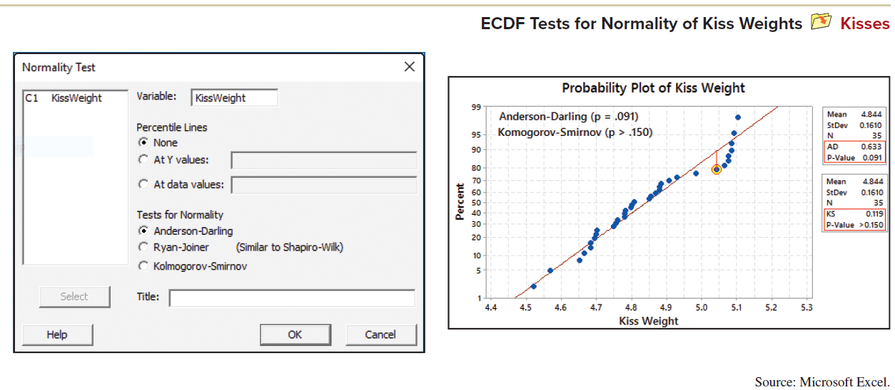
ECDF Tests
LO 15-8
K-S test can be illustrated in the same probability plot as the A-D test as shown.

Slide 52
Chapter 15 Practice Problems

Slide 53
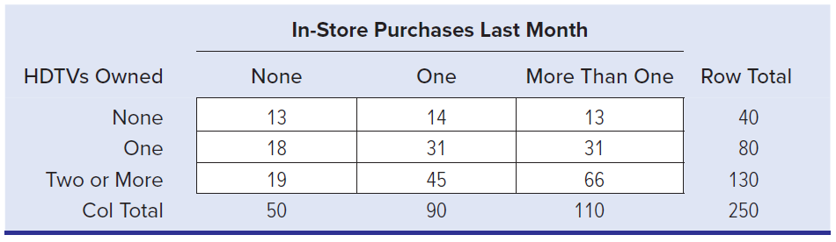
Question 4
LO 15-3
Is HDTV ownership related to quantity of purchases of other electronics? A Best Buy retail outlet collected the following data for a random sample of its recent customers. Research question: At α = .10, is the frequency of in-store purchases independent of the number of large-screen HDTVs owned (defined as 50 inches or more)?

Slide 54
Question 6
LO 15-4
U.S. market share for smartphones with larger screens is increasing. As of the first quarter of 2011, smartphones with screens 4 inches or larger had captured 24 percent of the smartphone market. The market for smartphones with screens between 3.5 and 3.9 inches has stayed fairly steady at 40 percent, while that for smartphones with screens less than 3.5 inches has declined to 36 percent. Does smartphone ownership by college students follow this national pattern? A sample of 148 student smartphone users showed that 30 owned a smartphone with a large screen (4 inches or greater), 75 owned a smartphone with a medium-sized screen (between 3.5 and 3.9 inches), and 43 owned a smartphone with a small screen (less than 3.5 inches). Conduct a chi-square GOF test to answer this research question.

Slide 55
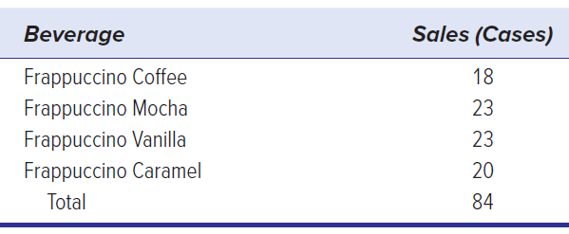
Question 9
LO 15-5
One-year sales volume of four similar 20-oz. beverages on a college campus is shown.
a. Make a bar chart and describe it.
b. Calculate expected frequencies for each class.
c. Perform the chi-square test for a uniform distribution. At α = .05, does this sample contradict the assumption that sales are the same for each beverage?

Slide 56
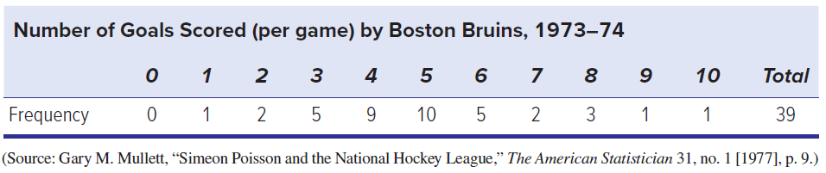
Question 13
LO 15-6
During the 1973–74 hockey season, the Boston Bruins played 39 home games and scored 193 points, as shown below.
a. Estimate the mean from the sample.
b. Calculate the expected frequencies assuming a Poisson distribution. Show your calculations in a spreadsheet format.
c. Carry out the chi-square test, combining end categories as needed to ensure that all expected frequencies are at least five. Show your degrees of freedom calculation.
d. At α = .05, can you reject the hypothesis that goals per game follow a Poisson process?

Slide 57
Chapter 15 Analytics in Action

Slide 58
